Slide 1
PLEASE NOTE – The recorded demos have been removed from this file to make sure it can be uploaded easily.
In order to see this content please find this talk on YouTube as presented at Birmingham Power BI Meetup on 7th May 2025 – link below.
https://youtu.be/MpThwTqmIyA?si=hS6K-gjqx9BpzNZi

Slide 2



Elevate User Confidence with Automated Testing in Power BI and cats!

Slide 3













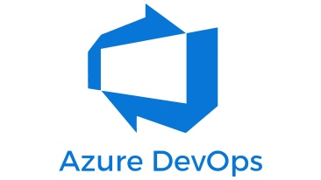


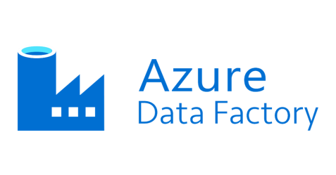



SARAH ABNETT
Notes:
Introduction to me
I’m from Birmingham
Went to uni
Worked at places
I am NOT a consultant, I’m a normal Dev of many names: SQL, ETL, BI
I’m very interested in DevOps and DataOps

Slide 4
Overview
A problem
A solution
Demo
Other uses

Slide 5
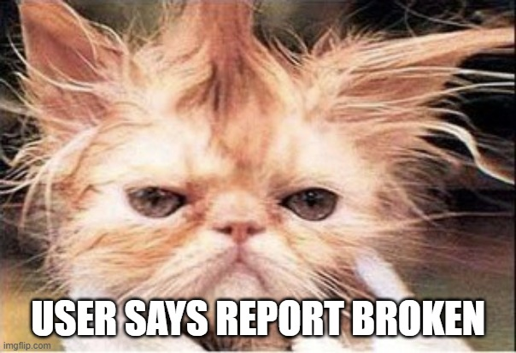
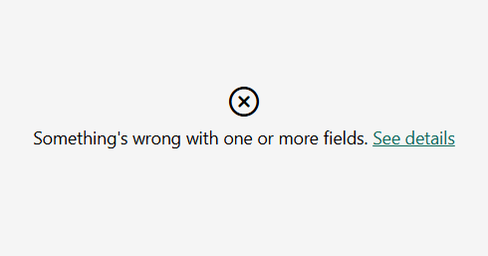
The Problem:
Notes:
The problem
A user contacts you. There is a problem with one of your reports.
You want to say: it is probably a user error – have you tried clearing filters? Hit that reset button!
But no, it IS broken
A visual is greyed out with this error message

Slide 6
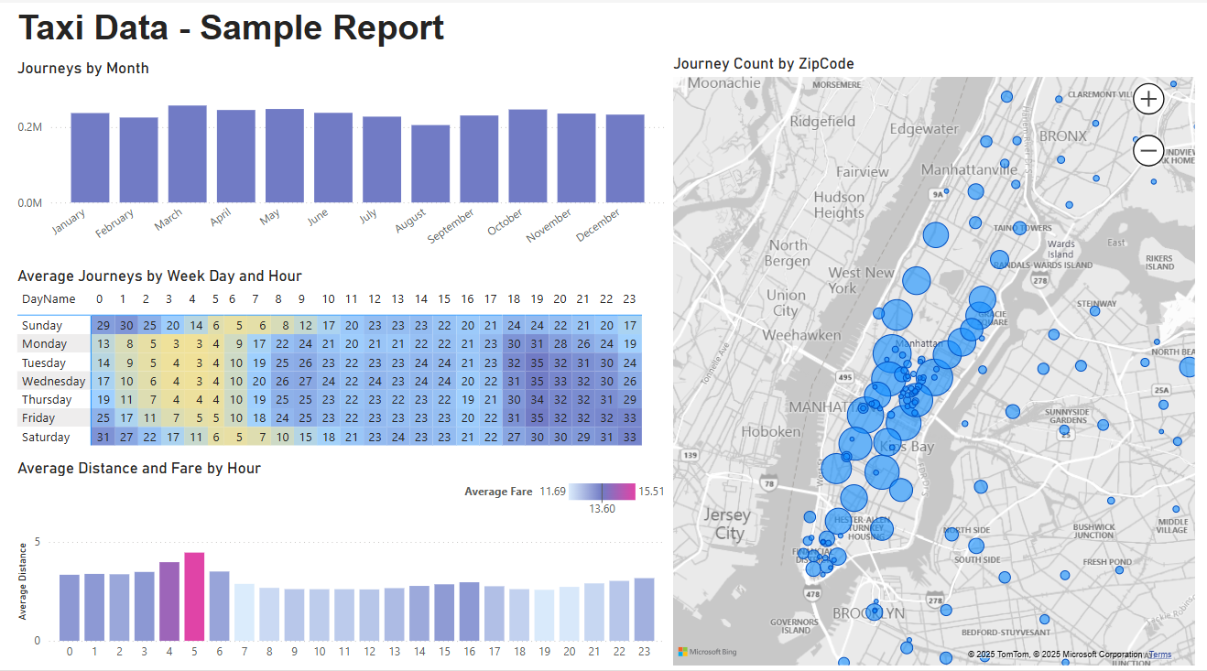
The Problem:
Notes:
My report should look like this, BUT….

Slide 7
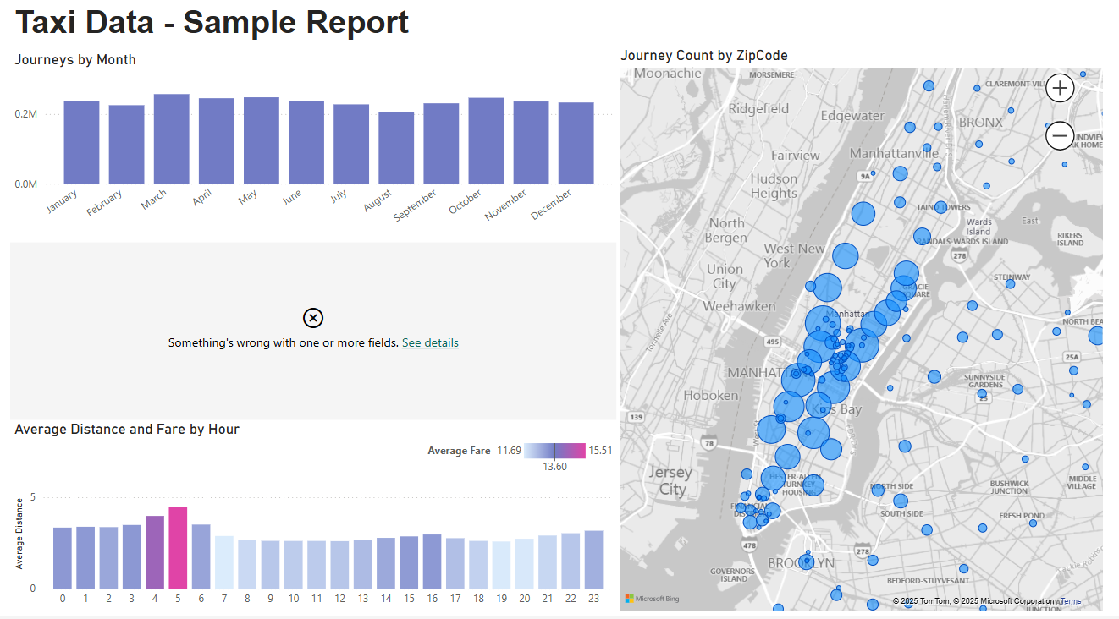
The Problem:
Notes:
And now my report looks like this – a broken visual

Slide 8
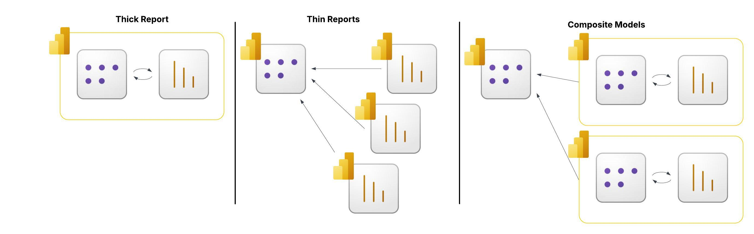
The Cause:
Beginner
Enterprise
Notes:
So the cause is – a change has been made to the model and a field ore measure has been removed or renamed but it was being used by a visual.
Here I’m trying to show the different ways you might set up your semantic models and reports.
Beginner level, or for smaller data sets and smaller teams you may be correct to stay working with ‘thick files’ where the data is wrapped in to the same file as your report.
For larger teams and larger data sets it makes more sense to move away from this way of working, to have bigger, more complex models that are maintained by a dedicated team.
It makes sense to invest more time in to refining your semantic models to make them very useful and to link more than one report up to that model. You may end up with many many reports reading from one model and it will be difficult to check every downstream report page when making changes to the model.

Slide 9


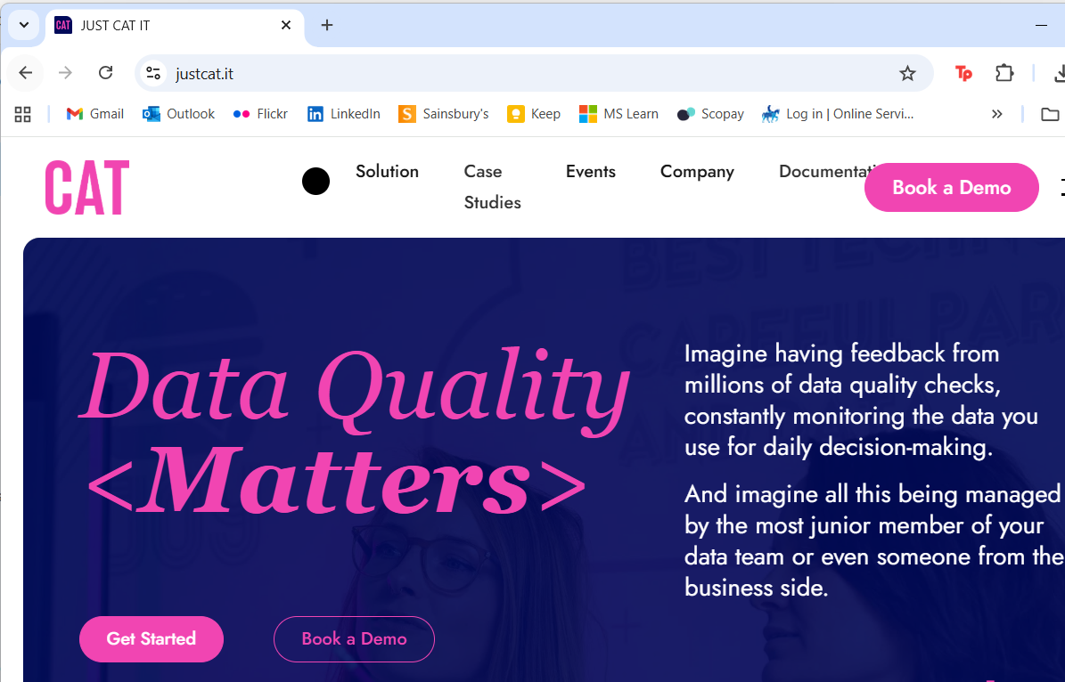
The Solution
Implement a test automation tool called CAT
Notes:
CAT
Has a free usage level
Costs for enterprise level use
Simple, lightweight

Slide 10
The Solution
What can I do with CAT?
Define a wide range of data sources: local files, SQL Server, Fabric, Semantic Models
Use different query languages: SQL, DAX
Define expectations: set is empty, sets match, contains
Notes:
CAT
Has a free usage level
Costs for enterprise level use
Simple, lightweight
Can be used as part of the CI/CD pipelines but in this scenario I suggest we run this regularly as a independent process that runs every day, hour or x minutes.

Slide 11
Pre-requisites
Code
PowerShell
YAML
DAX
Tools
Power BI
Fabric
Azure DevOps
VS Code
Github
CAT
Notes:
YAML – what is YAML?
- Used for configuration
- Human readable
- might stand for ‘Yet another mark up language’
Powershell – what is powershell?
- used for automation and configuration management
- consists of
- a command line shell
- and scripting language

Slide 12
Demo Overview
Set up a service principal (SP)
Store SP credentials in Environment variables
Install PowerShell 7 and CAT
Create a CAT project
Write tests
Run
Let’s create a script that can run many checks against a semantic model in one execution.

Slide 13
Set up a service principal
Go to: Azure Portal > Microsoft Entra ID > App Registrations
Create new App Registration
Go to: Power BI Admin Portal > Tenant Settings > Developer Settings
Enable the setting: Service principals can use Fabric APIs.
Go to the target workspace > Manage access > add service principal as admin
Grant the Service Principal access to the workspace
Notes:
WHY do we want a service principal??

Slide 14
Store credentials in Environment variables
Create environment variables using command prompt and this syntax. setx [Variable_Name] [Variable_Value]
The Service Principal Application ID should have this format app:[Application ID]@[Tenant ID]
It should look like this: setx ServicePrincipal_ApplicationID app:808c5b28-3117-48bc-a76e-cd33bf9e8011@40345a11-354c-49f5-90e2-991899b6XXXX setx ServicePrincipal_Secret xxxxx
To check your environment variable values use the command set or in powershell dir env:
Notes:
WHAT IS AN ENVIRONMENT VARIABLE? Using this process for environment variables will set them for the machine and make them available for any terminal.
Alternatively you could create them temporarily per session

Slide 15
Generate tests from pbix file
Create or change a Power BI report that uses a shared semantic model
When the report is ready for release save the file as a pbip
Extract all measures and columns referenced in the report.json file
Generate a bank of CAT tests

Slide 16
Automation with Azure DevOps
Azure DevOps
Create a variable group
Add your Service Principal name and secret
Add the license key for CAT
Create runtests.yaml
Define the pool (machine) that executes the tasks
Define Environment Variables using your DevOps variables
Install MSOLAP
Install CAT
Invoke CAT
Publish test results
Create pipeline
Grant pipeline access to the variable library
Run the pipeline
Notes:
WHAT IS DEVOPS?
Make a point about this being a full automation – no manual interaction

Slide 17
Other Uses
Migration projects: check your new platform matches your old platform
Test driven development: write a test that catches a bug, it should fail until your fix has been released
Any issues reported by users: create tests to ensure you catch these first

Slide 18
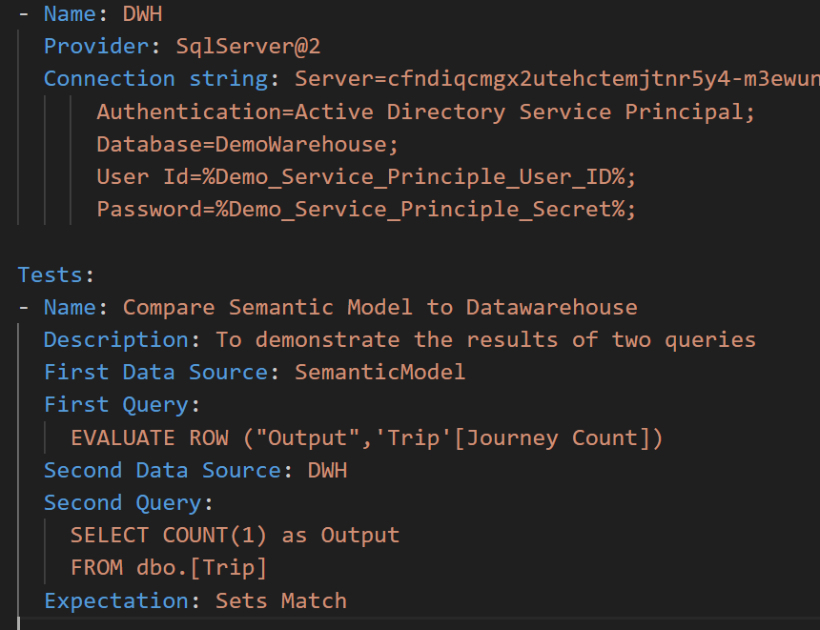
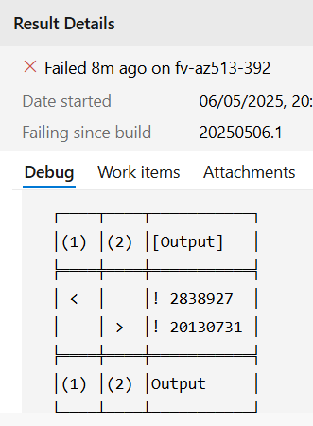
Other Uses: Migration
Add a data source for the Warehouse in Fabric
Create a ‘Sets Match’ test case
>> Test result details are visible in Azure DevOps to help resolve issues

Slide 19



References
Please reach out or connect, especially if you have any questions
https://www.linkedin.com/in/sarahabnett/
All code resources for the demo are available here
https://github.com/sarah-abnett/AutomatedTesting
Just cat website has really useful info for lots of other use cases
https://justcat.it/

